Slide 1
CVD Risk Factor Analysis and Prediction
Summer Training Project
Sitaram Manepalli | LPU | 2025

Slide 2
Aim of Project
To analyze health dataset and identify key risk factors for Cardiovascular Disease (CVD).
To build predictive model for assessing patient risk levels.
To create interactive Power BI dashboard for clear visualization.

Slide 3
Training Overview
Domain: Data Science & Machine Learning
Tools: Python (Pandas, NumPy, Seaborn, Matplotlib, Scikit-learn), Power BI
IDE: Jupyter Notebook
Duration: 10 June - 18 July 2025

Slide 4
Dataset
Source: Mendeley Data
Dataset: CAIR-CVD-2025 (Bangladesh Health Data)
Features: Demographics, clinical metrics, lifestyle factors
Usage: Data cleaning, EDA, hypothesis testing, modeling

Slide 5
Methodology
1. Data Cleaning & Preprocessing
2. Exploratory Data Analysis (EDA)
3. Hypothesis Testing (Z-test, T-test)
4. Predictive Modeling (Logistic Regression)
5. Dashboard Creation (Power BI)

Slide 6
Project Architecture
Data Input (CSV) → Preprocessing (Python) → EDA → Modeling → Visualization (Power BI)

Slide 7
Tools & Technologies
Python Libraries: Pandas, NumPy, Seaborn, Matplotlib, Scikit-learn, SciPy
Power BI for dashboard
Jupyter Notebook for implementation

Slide 8
Code Snippets & Visualizatios
Includes:
BMI vs CVD risk score
Histograms & Boxplots
Correlation Heatmap
Logistic Regression Model

Slide 9
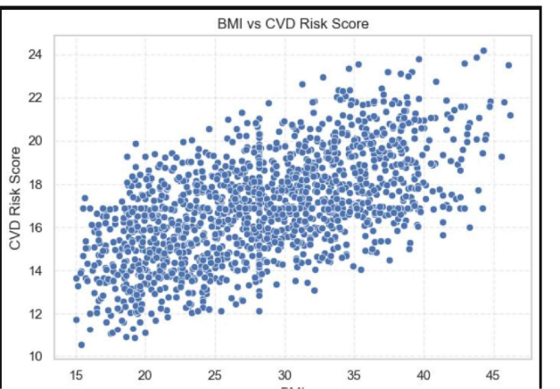
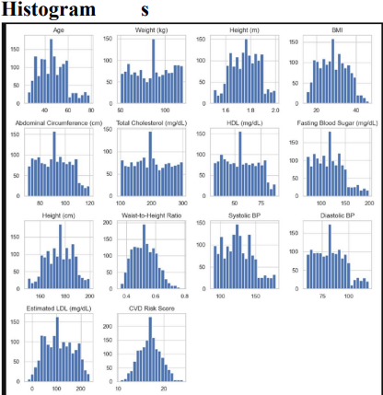

Slide 10
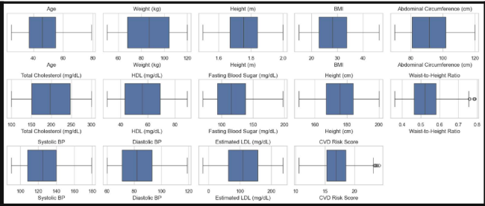

Slide 11
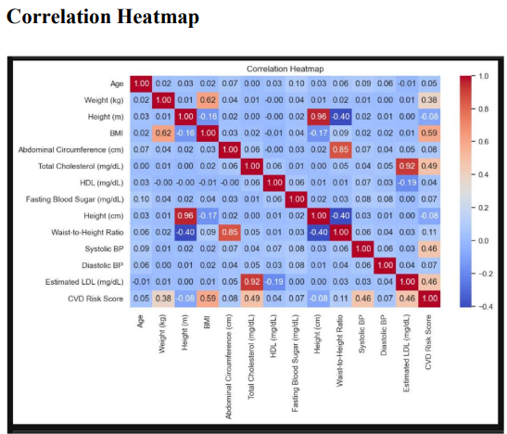

Slide 12
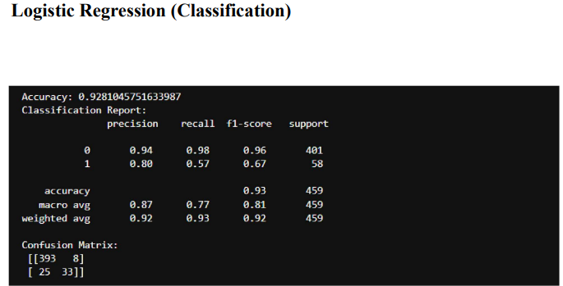

Slide 13
Results & Insights
Logistic Regression Accuracy: 93%
Key Risk Factors: BMI & Systolic BP
Visual insights via Power BI dashboard

Slide 14
Power BI Dashboard Snapshots
Patient Health Overview
Lifestyle & Risk Factors
Blood Pressure & Cholesterol Insights

Slide 15
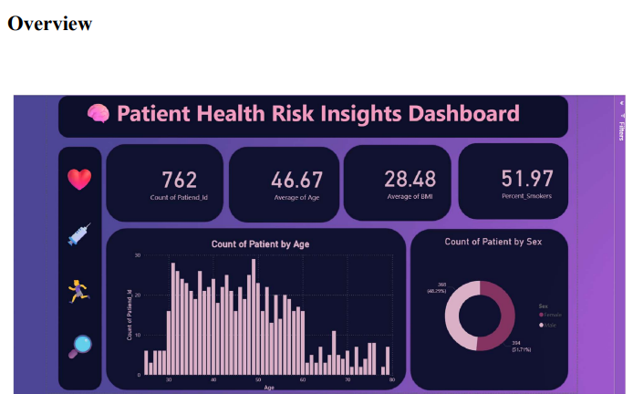

Slide 16
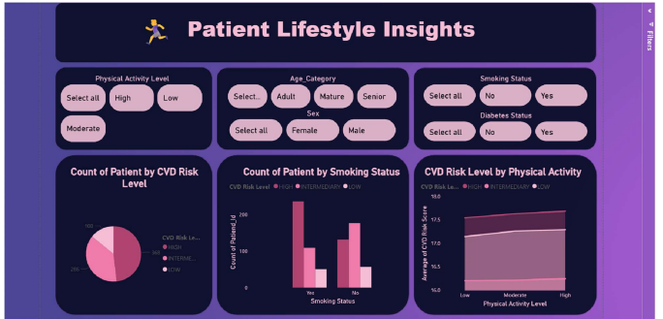

Slide 17
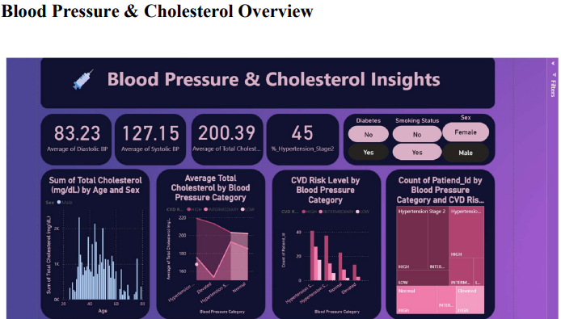

Slide 18
Challenges Faced
Handling missing values
Class imbalance (High-risk minority)
Ensuring unbiased imputation strategies

Slide 19
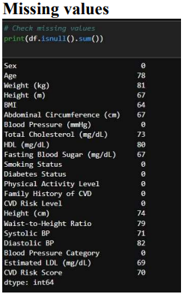

Slide 20
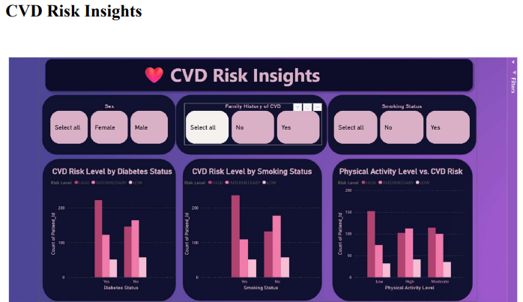

Slide 21
Learnings
Complete data science pipeline implementation
Applied hypothesis testing effectively
Enhanced storytelling via dashboards

Slide 22
Conclusion
Early CVD detection is possible using data science techniques
Predictive modeling aids preventive healthcare
Power BI dashboards make results accessible to non-technical users

Slide 23
Certificates
Certificate of Completion from LPU Skill Development
Recognition for hands-on data science project

Slide 24


Slide 25


